Slide 1

Biofuels: Social, environmental and economic concerns
Georgios Avgerinopoulos
gav@kth.se
Introductory lecture – Energy commodities and technologies
This work by OpTIMUS.community is licensed under the Creative Commons Attribution 4.0 International License. To view a copy of this license, visit http://creativecommons.org/licenses/by/4.0/.

Slide 2
Global trends
Biofuels: overview
Economic concerns
Environmental concerns
Social concerns

Slide 3
Biofuels: overview
First generation biofuels (1G) – produced from food-grade biomass by natural microbiological processes.
Example: vegetable oils, ethanol, biogas from crops.
1G non-food biofuels – produced by natural processes but from non-edible biomass, i.e. from organic residues, sewage sludge or garbage.
Example: biogas.
Second generation biofuels (2G) – produced by advanced thermochemical conversion methods from non-edible biomass feedstocks.
Example: alcohols or biosynthetic fuels from wood or from another lignocellulosic material!
Third generation biofuels (3G) – based on more productive, special grown non-food biomass feedstocks.
Example: algae, genetically modified or hybrid crops, artificial photosynthesis.

Slide 4
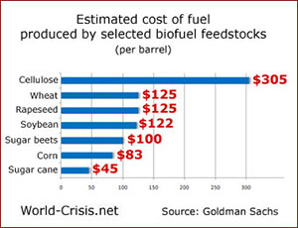
Biofuels: overview
Utilized in thermal power plants, boilers and suitable vehicles
Thermal efficiency 35-40-% of ICE, up to 90% in the case of cogeneration
Base load supply
Power plant cost comparable to fossil fuels
Biofuel production cost depends on the fuel type

Slide 5
Biofuels: economic concerns
Susceptible to aging and freezing
Difficult to maintain the production process in small scales
Existing infrastructure can sometimes handle biofuels but in many cases modification or equipment replacement is required

Slide 6
Biofuels: environmental concerns
Deforestation
Reduction in biological diversity
Erosion
Typically high input of energy required (fertilisers, harvesting processing)
New agricultural land, less retention of water in soil, desertification (higher evapotranspiration)
Improper irrigation of energy crops => soil salinity
Ground water pollution due to fertilisers
H2O for biogas production and distilleries =>
Production of waste water rich in N2, phosphorous and potassium.

Slide 7
Biofuels: social concerns
Biofuel production requires significant amounts of water (often scarce). This leads to a clear trade-off in water allocation.
Land use conflict. Biomass alone can NOT be a single source of both fuel and food for the growing population on planet Earth. Efficient production/conversion/utilisation methods should be sought.
Visual impact on land.

Slide 8
Technologies in the biofuels chain
Biomass production
Biogas and bio-synthetic gas production
Biomass for heat and power

Slide 9

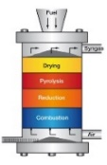


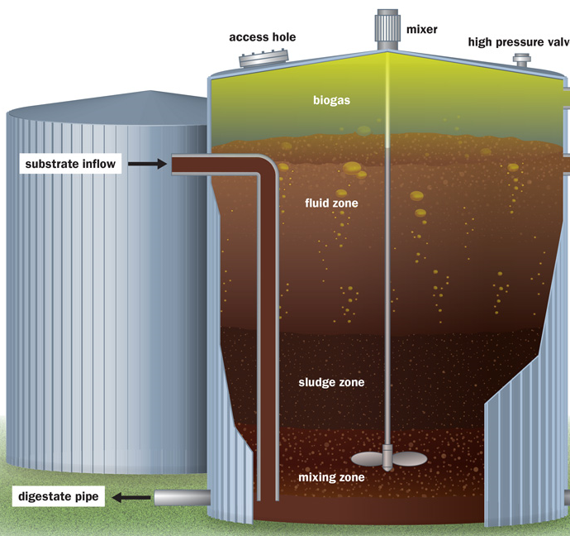

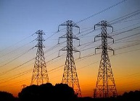

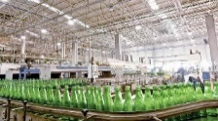
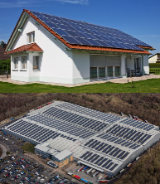
Sample Reference Energy System: biofuels
Energy demand
Transportation sector
Combustion-based
power plant
Energy demand
Residential sector
Bio-synthetic gas
Import / Production of biomass
Biogas
Electricity
Electricity transmission and distribution
Energy demand
Commercial sector
Biomass
Energy demand
Industrial sector
Decentralised energy supply
Heat
Notes:
Biofuels contribute to the energy supply in many ways: they are usually employed for power and heat supply both at a centralised and at a decentralised level.

Slide 10
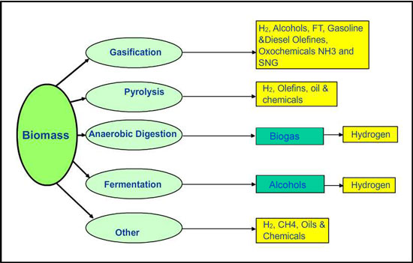
Processes for bioenergy conversion

Slide 11
Biomass Production
Key characteristics
Pellet Production Plant (40,000 t/yr capacity)
Capital cost | 4866 k$
FOM cost | 225 k$/a
Energy use | 0.410 GJ/t pellets
Utilization factor | 91%
Biomass is comes from agriculture/forest products/residues as well as waste.
Various harvesting or collection methods are applied.
Treatment includes chipping, drying, pelleting and torrefaction.
Transport is done by truck, train and ship.
It can be either used in solid form (e.g. chips or pellets) or converted in to liquid fuels (ethanol, biodiesel, etc.), or gas (syngas, biogas).

Slide 12
Biogas and bio-synthetic gas production
Key characteristics
Anaerobic digester
Capital cost | 5000-7500 USD / Nm3/h
FOM cost | 2-7% of capital
Energy use | Up to 15% of feed
CO2 emission factor | 11-20 gCO2/MJ
Biogas usually produced by anaerobic digestion. Applications also in developing countries and rural contexts.
Bio-syngas production less mature. Gasification technologies work on same principles as those for coal. Potentially higher production rates.

Slide 13
Biomass for Heat and Power
Key characteristics
Biomass CHP plant
Capital cost | 3000-6000 $/kW
FOM cost | 100 $/kW/a
Fuel cost | 30-50 $/MWh
Electric Efficiency | 16-36%
Totall Efficiency | 40-85%
The most common application of biomass in the energy sector is combined heat and power (CHP) generation.
CHP (if not for industrial use) is coupled with district heating.
Co-firing of biomass/biogas with coal/natural gas respectively is possible with a few adjustments.

Slide 14
References and reading material

Slide 15
IEA, World Energy Outlook 2016;
European Commission, Joint Research Centre, Energy Technology Reference Indicators (ETRI) 2014. Available at: https://setis.ec.europa.eu/sites/default/files/reports/ETRI-2014.pdf;
IEA, NEA, Projected Costs of Generating Electricity 2015. Available at: https://www.oecd-nea.org/ndd/pubs/2015/7057-proj-costs-electricity-2015.pdf;
IEA-ETSAP, Energy Technology Data Source. Available at: https://iea-etsap.org/index.php/energy-technology-data;

Slide 16
Sources for the RES pictures
Gasification: http://www.gbgasifired.com/model.html
Extraction: http://www.energytrendsinsider.com/research/coal/coal-mining-and-processing/
Refinery: http://stillwaterassociates.com/crack-spread-a-quick-and-dirty-indicator-of-refining-profitability/
Biomass: http://inhabitat.com/tag/biomass/
Renewables: http://www.topnews.in/wind-water-and-sun-beat-biofuels-nuclear-and-coal-clean-energy-297577
Uranium: http://unitednuclear.com/index.php?main_page=product_info&products_id=1028
Fossil: https://www.slideshare.net/MMoiraWhitehouse/fossil-fuels-teach
Combustion based power plants: https://en.wikipedia.org/wiki/Battersea_Power_Station_in_popular_culture
Uranium enrichment: http://energyfromthorium.com/2010/08/06/loveswu1/
Residential: http://jhsimpson.com/residential/
Transport: https://se.123rf.com/clipart-vektorer/transport.html
Industry: http://indianexpress.com/article/business/economy/factory-output-grows-2-per-cent-in-february-after-3-months-of-contraction/
Commercial: http://www.alfalaval.com/industries/refrigeration/commercial-refrigeration/
Transportation of fuel: http://www.zerohedge.com/news/2017-06-23/demand-oil-pipeline-capacity-hits-6-year-low
Transportation of biomass: http://www.forestenergy.ie/transportation-studies.php
Transportation of oil products: http://www.picquery.com/gasoline-truck_WXRZaplkZ2eaRVifu*zjqPAvrMnnxmBsTSgdn*BBBKk/

Slide 17
Sources for the RES pictures
Decentralized energy supply: http://trayamtechnologies.com/solar-pv-roof-top-and-ground-mounting/
Decentralized energy supply2: http://www.sunwindenergy.com/photovoltaics/38-mw-rooftop-pv-system-completed-uk
Biogas and bio-synthetic gas production: https://ehp.niehs.nih.gov/123-a180/
Onshore wind: https://www.mitchelltech.edu/programs/on-campus/energy-production-transmission/wind-turbine-technology
Offshore wind: http://inhabitat.com/tag/offshore-wind-farm/
Solar tower: http://www.power-technology.com/projects/seville-solar-tower/seville-solar-tower1.html
PV panels: https://dir.indiamart.com/coimbatore/solar-pv-panel.html
Solar power area requirements: http://forums.mwerks.com/showthread.php?7477561-Global-Energy-Thread
Bioenergy conversion: http://14.139.172.204/nptel/CSE/Web/103102022/environmental%20issues%20and%20new%20trends/ecological%20consideration%20in%20petroleum%20refinery.html

Slide 18
Changelog and attribution
Date | Author | Reviewer | Reviser
2017-09-26 | Georgios Avgerinopoulos | Mark Howells | Georgios Avgerinopoulos
To correctly reference this work, please use the following:
Avgerinopoulos, G., 2017. Biofuels: Social, environmental and economic concerns, OpTIMUS.community. Available at: http://www.osemosys.org/understanding-the-energy-system.html. [Access date]

